Slide 1
A Star Wars themed review

Slide 4
Episode X: Attack of the dreaded dimer
As General Landman chases
COVID -19 Across the Galaxy, the ED Jedi Council is busy taking care of BAU
A Young ED padawan asks for advice about a patient with chest pain and SOB (eye roll)
The force is not very strong in this
Case, and she may yet have to use
Recent medical literature to help
Inform her decision. Should she send
The d-dimer or not????
The Jedi Master is confident in the
Ways of the WELLS and PERC Score
The ED Jedi calmly mentions a
Recent paper to help inform
The decision
‘Use the force…and be at one
With the ways of the d-dimer!‘

Slide 6
….What this talk is and is not…
Notes:
Not a thorough review of how to workup someone with suspected PE. Not a complete review of all recent literature on this topic. Not covering Age adjusted and pregnancy adjusted d-dimer.
IS” The point is to get to the article in question and why I think we should pay attention to it…has the potential to reduce the number of CTPA’s we do
Three approaches to the workup of PE: each one based on a star wars character

Slide 8
The Han Solo approach
Straight forward, no-frills.
A bit of a gamble
“NEVER TELL ME THE ODDS”
approach has collateral damage

Slide 9
The Han Solo approach
“ I have a patient with chest pain and SOB, I don’t know what is going on……I’m gonna send the d-dimer and hope for the best. What have I got to lose?”

Slide 10
And the d-dimer is???????
750
Notes:
so .... what do you think happens next?

Slide 11
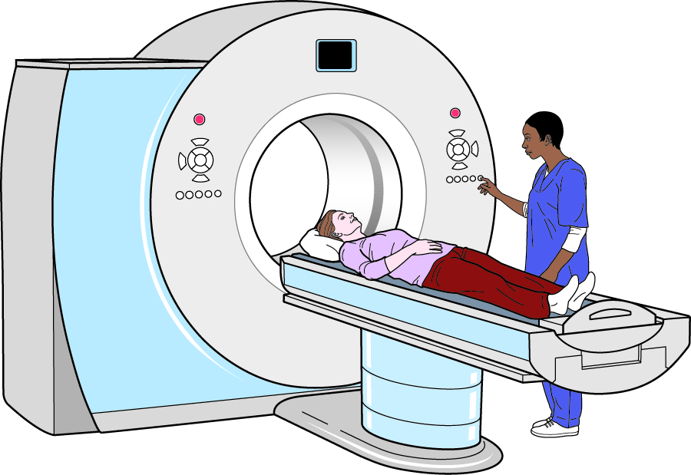

Slide 13
The C-3PO approach
Protocol Droid
Familiar, reliable and safe.
Intellectual and cautious.
Though not fool-proof
Evaluates “risk” . . . . Makes recommendations based on odds

Slide 15
The C3-PO approach
“I have a patient with SOB and Chest pain….i think it might be a PE and have reasonably excluded other things. The Wells score puts them at low-ish risk so I will send the d-dimer and if its less than 500, then I’ve reasonably ruled out PE”

Slide 16
And the d-dimer is???????
750

Slide 17
The C-3PO approach
“good heavens”
“If I use the Fagan nomogram, the post test probability is still low, however I haven’t yet managed to rule out PE…”

Slide 20
The Yoda approach
Jedi Master
Demonstrates equipoise and adaptability
His intelligence, wisdom and skills excel that of most Jedi masters.
Just seems to have the right answer!

Slide 22
What did this study do?
Prospective study
Enrolled patients with suspected PE
Three groups:
Low Risk Wells? D-dimer threshold increased to from 500 to 1000.
Medium Risk Wells? D-dimer threshold kept at 500.
High Risk Wells? CTPA
How many had VTE at 90 days if you were discharged from ED without imaging being done.

Slide 23
Exclusions
Age <18
Anticoags within 24 hours
Had major surgery within 21 days
Had chest imaging done for other reasons
Pregnant
Geographically isolated
On going anticoagulant need

Slide 24
Brief Methodology
Recruited when they presented to ED
Those with high wells scores got a CTPA.
Those with low wells and d-dimer <1000: NOT scanned and discharged immediately. No anticoags
Those with medium wells, and d-dimer <500: NOT scanned and discharged immediately. No anticoags.
Follow up at 90 days

Slide 25
90 day Follow up
Primary outcome =
Symptomatic, objectively verified venous thromboembolism (included PE or DVT
Follow up investigators blinded to d-dimer, diagnostic imaging, anticoagulant use.

Slide 26
Results.

Slide 27
85%
10%
5%

Slide 30
If Wells ”Low Risk” AND d-dimer <1000 then
PE was excluded in 1276/1276 patients!
PE was excluded in another 40/40
If Wells ”Medium Risk” AND d-dimer <500 then

Slide 31
Resulting in….
17% Absolute reduction of chest imaging.
33% Relative reduction of Chest imaging.
No missed cases.

Slide 32
Other Studies
YEARS study (Lancet 2017)
YEARS criteria + d-dimer safely excluded PE and had 14% decrease in CTPA use.
Study of Low risk WELLS for DVT and d-dimer <1000: again safely excluded DVT. (Annals of Int Med 2013).

Slide 33
The PeGGED and YEARS studies
PEGGED
YEARS
Prospective enrollment
Large number patients
Stratified into risk cohorts
“low risk”-> dimer threshold 1000
Clinically based end point at 3 months
Prospective enrollment
Large number of patients
Stratified into risk cohorts
“low risk”-> dimer threshold 1000
Clinically based end point at 3 months

Slide 34
The PeGGED and YEARS studies
PEGGED
YEARS
Safely excluded PE in low risk group. Zero missed cases
Less than 1% of those not scanned had symptomatic VTE at three months.

Slide 35
In Summary
“Have “low risk” wells and d-dimer less than 1000 do you?”
“Ruled out PE you have…hmmmmm…yesssssss”

